Slide 1
SWIFT OTA Development Manual
By TYM team

Slide 2
Three usual ways to OTA(1)
BOOT
APP
OTA
Legacy way
Code runs in APP partition, download new APP data to OTA partition.
Reboot the device, BOOT will copy new APP data from OTA partition to APP partition.
Jump to APP partition and run.
Advantage
If OTA is interrupted, the device will not be a brick even there is no network.
Disadvantage
More time cost(two times erase/write Flash).
More ROM size cost.

Slide 3
Three usual ways to OTA(2)
BOOT
APP
OTA
BIG/LITTLE way
Code runs in APP partition, keep a mini system in OTA partition.
When OTA begins, jump to OTA partition and download new APP data to APP partition.
Reboot the device to run in APP partition.
Advantage
Less time cost(one time erase/write Flash).
Less ROM size cost.
Disadvantage
If OTA is interrupted, next reboot will continue to OTA until OTA succeeds. If there is no network the device will be a brick.

Slide 4
Three usual ways to OTA(3)
BOOT
APP A
APP B
A/B way
If APP runs in A, OTA data will be downloaded to B.
Reboot the device, BOOT will remap to run APP in B.
On next time OTA, A will be rewritten and APP runs in A.
Advantage
If OTA is interrupted, the device will not be a brick even there is no network.
Less time cost(one time erase/write Flash).
Disadvantage
More ROM size cost.
We choose A/B way.

Slide 5
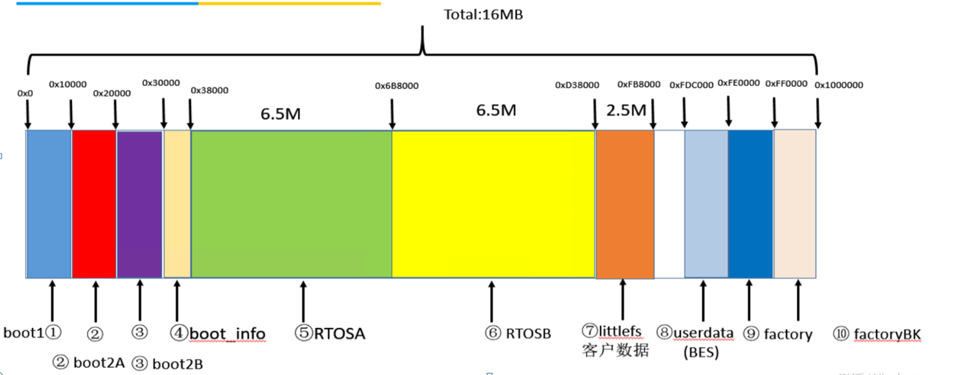
16M Flash partition mapping
SWIFT project uses 16M Flash, above is a typical partition mapping.
Code can found in services\wifi_app\littlefs\partition_conf.c
If partition size is fixed, we only need focus on RTOSA/B.

Slide 6
Detailed information for partitions
Partition Name | Can be OTA? | Can be signatured? | Remark
boot1 | N | Y | First boot.
boot2a | Y(if partition size changed) | Y | Second boot.
boot2b | Y(if partition size changed) | Y | Second boot, boot2a and boot2b is an A/B couple.
bootinfo | N | N | Boot information. Read by boot1 and boot2a/b, and written by RTOSA/B.
RTOSA | Y | Y | System main bin.
RTOSB | Y | Y | System main bin. RTOSA/B is an A/B couple.
littlefs | N | N | File system.
userdate(BES) | N | N | Discarded.
factory | N | N | Calibration data.
factory_bk | N | N | Calibration data(backup).
OTP | N | N | Signature key, stored in Flash OTP.

Slide 7
Boot process
BootROM
Boot2a or boot 2b data integrity OK?
N
Exception handling
Run boot1, read bootinfo to choose boot2a or boot2b
N
Read efuse to choose security boot
是
Y
Run boot2a or boot2b, read bootinfo to choose RTOSA or RTOSB?
Run boot2a or boot2b, read bootinfo to choose RTOSA or RTOSB?
Boot1 data integrity OK?
Exception handling
N
RTOSA or RTOSB data integrity OK?
N
Exception handling
Y
Run RTOSA or RTOSB
Run boot1, read bootinfo to choose boot2a or boot2b
是
Run RTOSA or RTOSB

Slide 8
OTA process
Download OTA files from cloud
A sample can be found in ‘apps\bes_test\libcurl\test_libcurl_client_http_ota.c’.
How to use
Configure ‘#define HTTP_OTA_URL http://192.168.0.111/test/best2600w_aiot.bin’ as your server config.
Build and run, connect WiFi and input ‘AT+CUST=13’
Write OTA to A partition
N
Current is A partiton?
Y
Download OK and Write OK.
Write OTA to B partition
Current is A partiton?
Y
Wirte bootinfo flag which switchs to B partition next boot
N
Wirte bootinfo flag which switchs to A partition next boot
Reboot

